Slide 1

Business presentations
Preparing effective oral presentations

Slide 2

Types of Business Presentation
Briefings: concise summary of an issue, proposal, or problem.
Reports: progress, status, convention.
Podcasts: prerecorded audio clip delivered online.
Virtual Presentations: used when collaborating remotely.
Webinars: Web-based presentation, lecture, workshop, or seminar.

Slide 3





The Stages in Preparing and Organizing Oral Presentations
Identify your purpose
Identify your Audience
Organise the content for a powerful Impact
Build Audience Rapport Like a Pro
Planning Visual Aids and Multimedia presentation

Slide 4
Designing an Impressive Multimedia Presentations
Polishing your delivery and Following up
Nine techniques for gaining and keeping audience attention
How to avoid stage fright
Checklist for preparing and organizing oral presentation

Slide 5



Identify Your Purpose
What do you want to accomplish?
What do you want your listeners to remember or do?
Decide what you want your audience to believe, remember, or do when you finish.

Slide 6
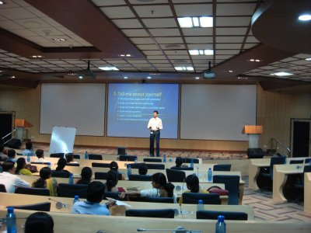
2. Purpose of Presentation
general purposes of a presentation can be
To inform
To persuade
To entertain
To create awareness
To demonstrate
To motivate audiences to take a particular action
To inspire
To explain and convince, etc

Slide 7
Specific purpose of presentation:
The audiences will have the required background information about a topic for future research
The audience will acknowledge the validity of the speaker’s claims and opinions
The audiences will support the presenter on a particular issue
The audience will fully understand the details of a topic or subject, etc.
Exercise: Page 68

Slide 8



Know your Audience
Age
Gender
Education and Experience
Size of the audience

Slide 9
Types of Audience
Friendly
Neutral
They like you and your topic
They are calm and rational
Uninterested
Hostile
They maybe there against their will or short attention span
They want to take charge and ridicule the speaker, they maybe defensive or emotional

Slide 10
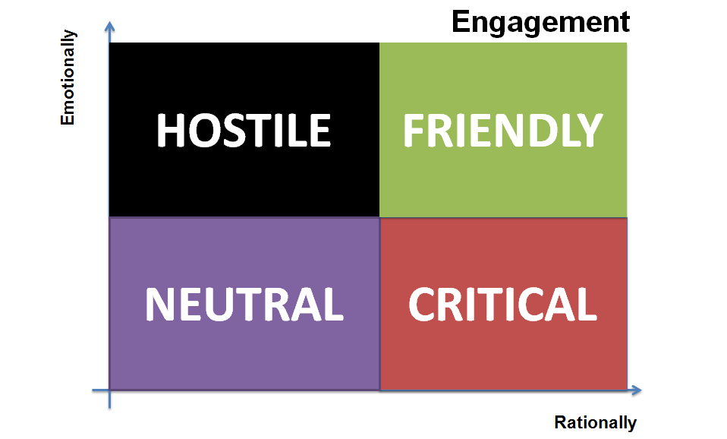
Delivery Styles according to Types of Audience
Be warm, pleasant, and open. Use lots of eye contact and smiles.
Be controlled. Do nothing showy. Use confident, small gestures.
Be dynamic and entertaining. Move around. Use large gestures.
Be calm and controlled. Speak evenly and slowly.
UNINTERESTED

Slide 11
Context Analysis
Time Alloted
Educational
Professional
Situation in which communication takes place
International Conference
Local Conference

Slide 12

Organise the content for a powerful Impact
Tell them what you are going to say
Say it
Tell them what you have just said

Slide 13
introduction
Capture listeners’ attention and get them involved.
Identify yourself and build your credibility.
Preview your main points.
Three goals

Slide 14
Attention grabbers
Get the audience involved.
Let them know why they are there
Grab their attention
Capture attention by opening with a promise, story, startling fact, question, quotation, relevant problem, or story.

Slide 15
Nine attention getter techniques
A Promise: By the end of this presentation I will have shown you how you can increase your sales by 50%.
Drama: Open by telling an emotionally moving story or by describing a serious problem that involves the audience.
Eye Contact: As you begin, command attention by surveying the entire audience to take in all listeners.
Movement: Leave the lectern area. Move toward the audience.
Questions: Ask for a show of hands. Use rhetorical questions.

Slide 16
Nine attention getter techniques
Demonstrations: Include a member of the audience. For example: I need a volunteer from the audience..
Samples: Award prizes to volunteer participants; pass out samples.
Visuals: Give your audience something to look at besides yourself. Consider writing the concerns expressed by your audience on white board as you go along.
Self-interest: Audience wants to know “What’s in it for me?”
Continue..

Slide 17



Establish your credibility And Preview main points
Your Position
Qualifications
Knowledge
Expertise

Slide 18
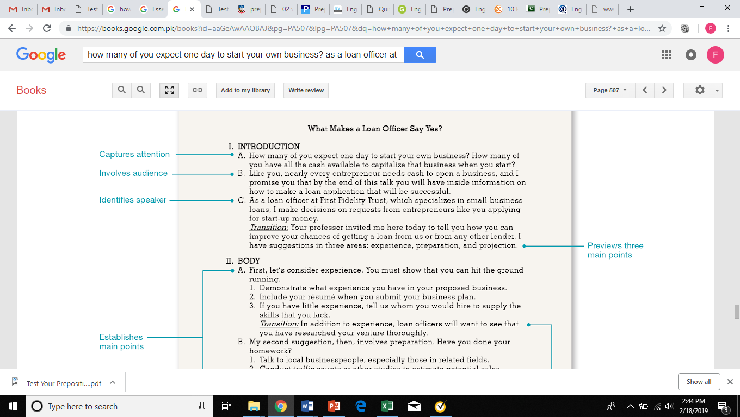
example

Slide 19

Organizing the body

Slide 20
Heart of the presentation
Focus on a limited number of main points (2-4).
Develop each point with adequate explanation and details.
Streamline your topic and summarize its principal parts.
Keep it simple.
Use transitions.

Slide 21
Arrangement of ideas
Chronology: describe the history the idea, from first point to last.
Space: changing diversity of the workforce (East cost, West cost, and so forth)
Importance: Describe five reasons why company should move its headquarters to other city. Start with the most important.
Comparison/Contrast: Compare organic with industrial farming.
few simple ways

Slide 22
Arrangement of ideas
5. Journalistic Pattern: Use five Ws to describe any idea or issue.
6. Problem/Solution: Describe declining sales and solutions for it.
7. Simple/Complex: Start with simple idea to complex idea.
8. Best Case/Worst Case: Whether two companies should merge or not.
continued

Slide 23

Summarizing in the conclusion

Slide 24
Three Goals
Summarize the presentation’s main themes.
Leave audience with a specific, noteworthy take-away.
Include a statement that allows you to leave the podium gracefully.

